Slide 1
Plato II
Plato’s Cosmogony
Dr. Stephanie Spoto sspoto@mpc.edu
Monterey Peninsula College
Gentrain
25 October 2018

Slide 2
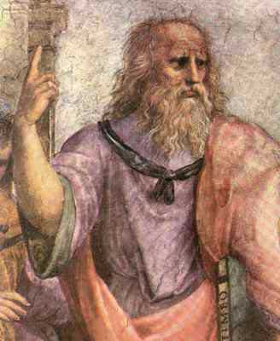
Timaeus
Plato’s cosmogony: Timaeus, 360BCE
  Athens falls to Sparta, 404BCE
  Socrates executed 399 BCE
Translated by Cicero into Latin → one of the only dialogues known to Europe during the Middle Ages
  Influenced Neoplatonism
Socrates normally “protagonist” of Plato’s dialogues, here place taken by Pythagorean, Timaeus of Locri
  Pythagorean account of the universe adopted
Raphael, The School of Athens, 1509-1511

Slide 3
(Un)changing universe
Unchanging world: apprehended by intelligence/reason
Changing world: perceived by opinion
Sensible world cannot be eternal → created by God
  “God desired that all things should be good, and nothing bad, as far as possible” (30a 1-3)
Does God create the universe or order pre-existing parts?
  “Finding the whole visible sphere not at rest, but moving in an irregular and disorderly fashion, out of disorder he brought order” (29e).

Slide 4
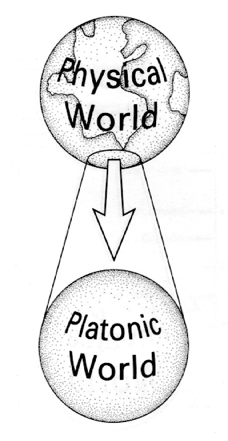
Soul, body, universe
God put intelligence in the soul; the soul in the body
The world is one living creature → soul & intellect
Only one world; designed to accord as closely as possible to the eternal original apprehended by God
World is one “animal,” understanding in itself all other animals
It is a globe, because it is the most perfect shape → rotates because circular motion most perfect motion

Slide 5
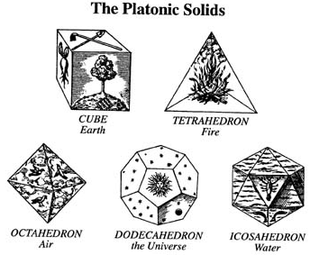
Elements
Four elements: earth, air, fire, and water
God used elements in harmony when he created the world → therefore it is perfect and not able to age or liable to disease
God created the soul first, then the body.
It is of a third, and intermediate kind of matter.

Slide 6
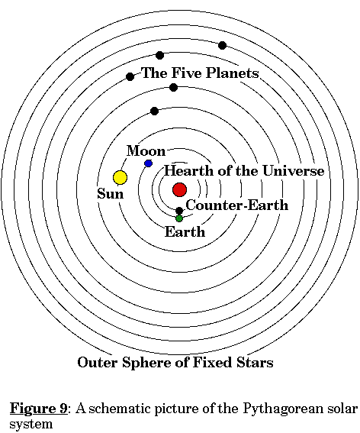
Pythagorean model of solar system
Pythagoras reasoned that the Earth was round → mast of the ship, curve of earth’s shadow on moon, sun/moon spherical
  Earth not the center of the universe → moral/religious grounds → humanity imperfect
  Hearth of the Universe at the center; Zeus’s throne
SUN → a glass sphere which reflected light of the hearth
Counter-earth hid the Hearth from earth so that humans could not see the face of God.

Slide 7
Pythagorean account of planets
& origin of time
When the father and creator saw the creature which he had made moving and living, the created image of the eternal gods, he rejoiced, and in his joy determined to make a copy still more like the original; and as this was eternal, he sought to make the universe eternal, so far as might be. Now the nature of the ideal being was everlasting, but to bestow this attribute in its fulness upon a creature was impossible. Wherefore he resolved to have a moving image of eternity, and when he set in order the heaven, he made this image eternal but moving according to number, while eternity itself rests in unity; and this image we call Time.
Timaeus, 37c-e

Slide 8
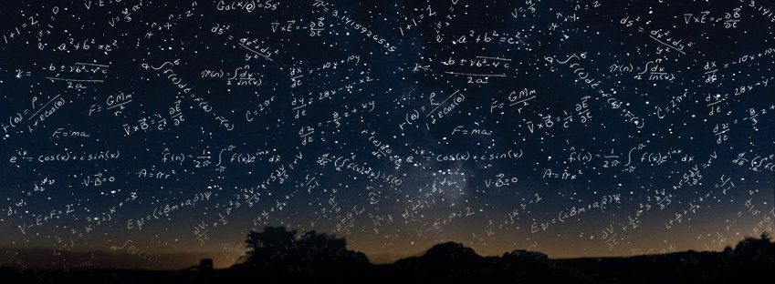
The natural world and mathematics
Time and the heavens come into existence simultaneously
The days and nights teach the animals:
That there might be some visible measure of their relative swiftness and slowness as they proceeded in their eight courses, God lighted a fire, which we now call the sun, in the second from the earth of these orbits, that it might give light to the whole of heaven, and that the animals, as many as nature intended, might participate in number, learning arithmetic from the revolution of the same and the like. Thus then, and for this reason the night and the day were created, being the period of the one most intelligent revolution. (Timaeus 37c-39e)

Slide 9
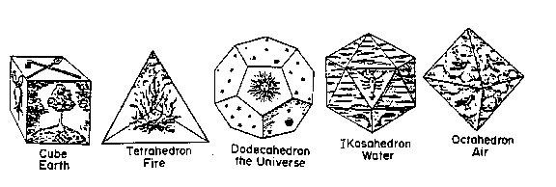
The true elements?
Timaeus says that there is an essential nature that is deeper than the true elements: two kinds of right-triangles (half a square and an equilateral)
The God created order from the confusion of the universe using these triangles (the most beautiful forms) to construct form
Using these two kinds of triangles, can construct the five regular solids: earth, fire, water, air, and the universe.

Slide 10
The mortal and immortal soul of humans
Two kinds of souls
  Created by God: immortal (the head)
  Created by the gods: mortal (the chest)
Mortal soul: “subject to terrible and irresistible affections—first of all, pleasure, the greatest incitement to evil; then pain, which deters us from good; also rashness and fear, two foolish counsellors, anger hard to be appeased, and hope easily led astray; these they (the gods) mingled with irrational sense and with all-daring love according to necessary laws, and so framed men.”

Slide 11
Plato and transmigration of the soul
Cowardly/unrighteous men will become women
Light-minded men, who think it is sufficient to look at the stars without learning mathematics will become birds
Those who don’t study philosophy will become wild land animals
The stupid will become fish

Slide 12
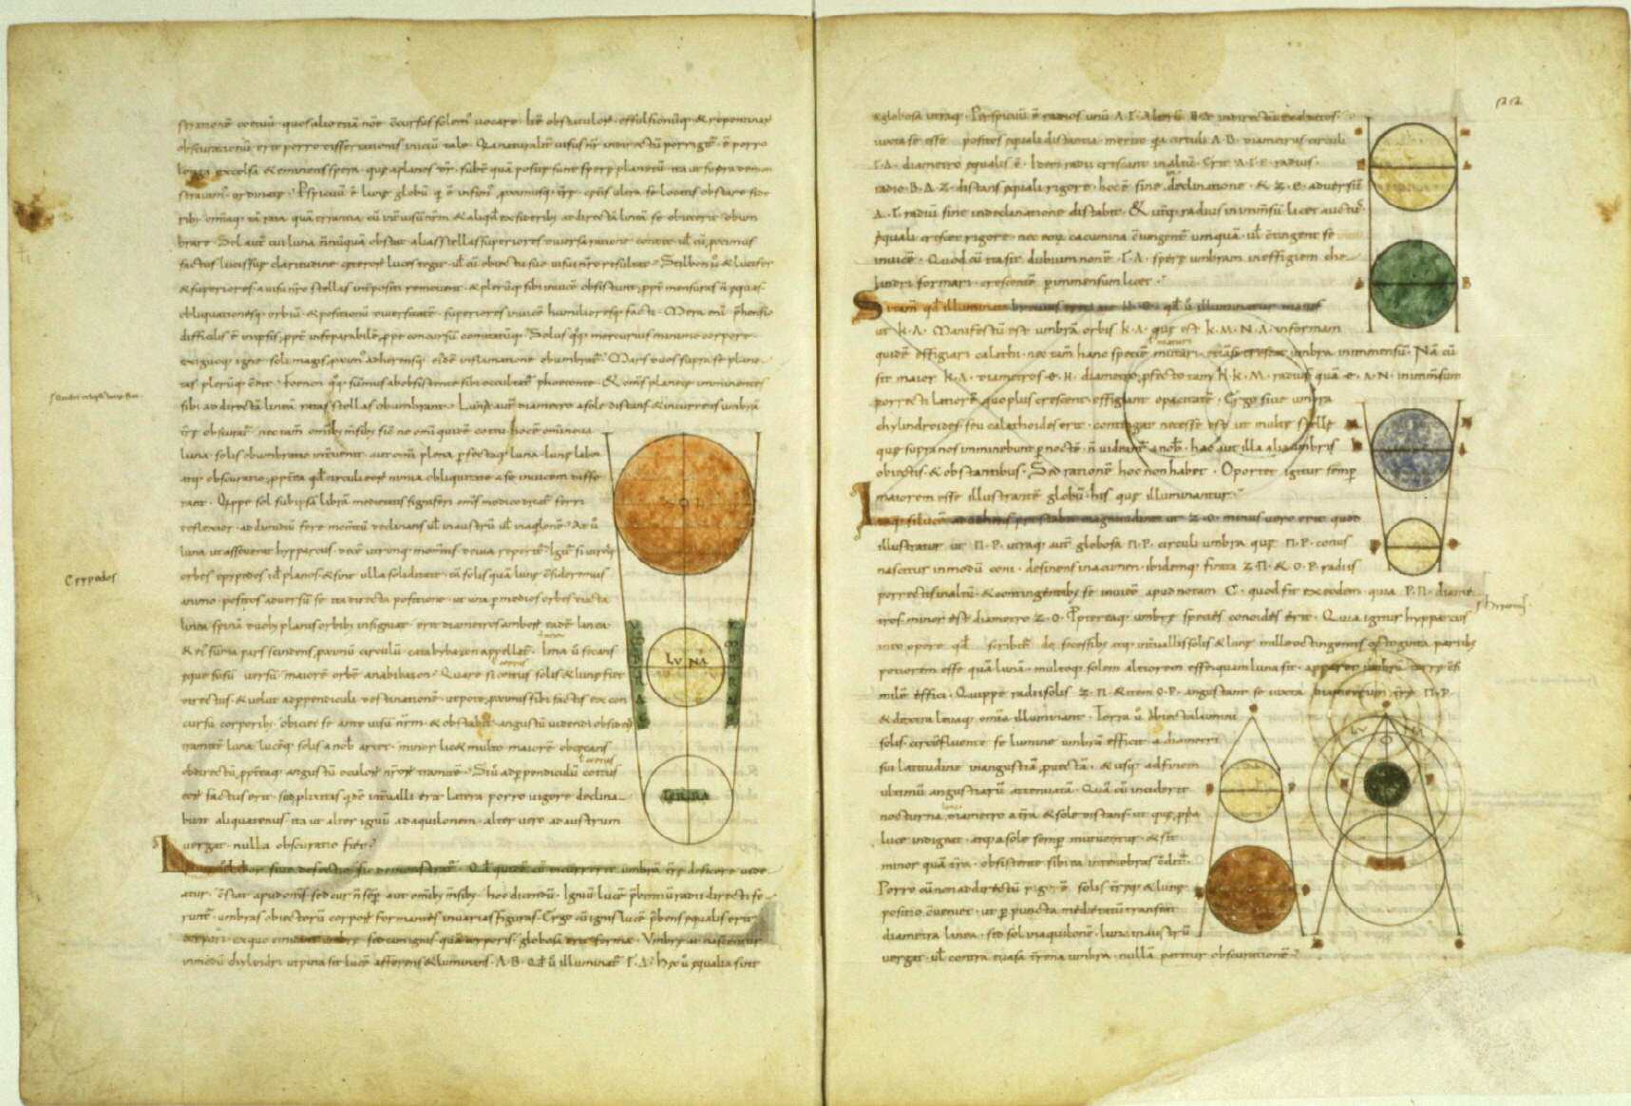
Medieval manuscript of Calcidius' Latin Timaeus translation.
Cicero and the first part (to 53c) was again translated by Calcidius c. 321 AD.
This Calcidius translation one of the only works of natural philosophy (and the only Platonic dialogue) available to early medieval readers in Latin.
Influenced Neoplatonic philosophy
Influenced Christian philosophers, such as William of Conches → creation ex nihilo

Slide 13
Coming weeks
Week 10 (Thurs Oct 25): 10:00-10:50, Aristotle
Week 11 (Tues Nov 6): 8:45-9:50, Plato and Aristotle on Art

